Slide 2
i-95 city of Richmond BRIDGE SUPERSTRUCTURE REPLACEMENT AND REHABILITATION BUNDLING
PROJECT INFORMATION PRESENTATION
City of Richmond, Virginia
Virginia Department of Transportation
Richmond District
Contract ID No. C00111300DB107

Slide 3
Project Goals
Rehabilitate 5 Structurally Deficient Bridges crossing I-95
  North 1st Street, North 4th Street, North 5th Street, North 7th Street, and East Broad Street Bridges
  Superstructure Replacements with some Minor Substructure Repairs
Bundle these five bridge rehabilitations into a single design-build procurement
  Capture cost and coordination efficiencies through bundling into single project/contract

Slide 4
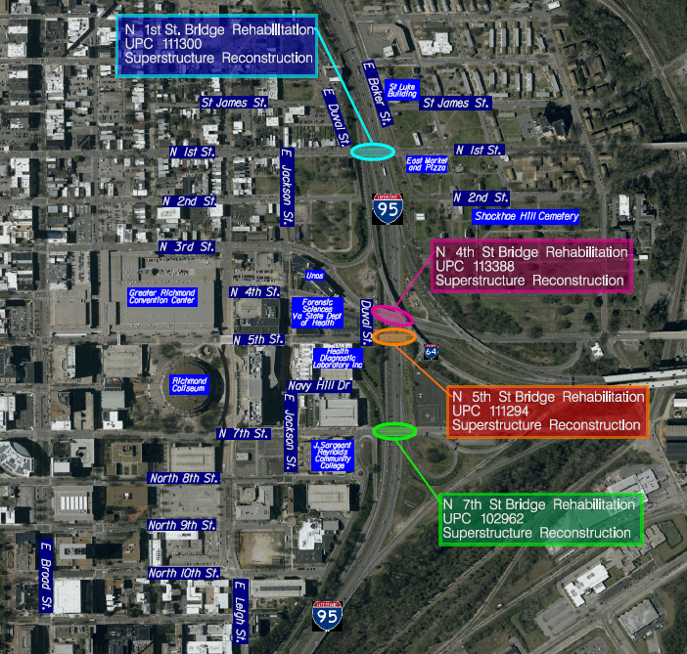
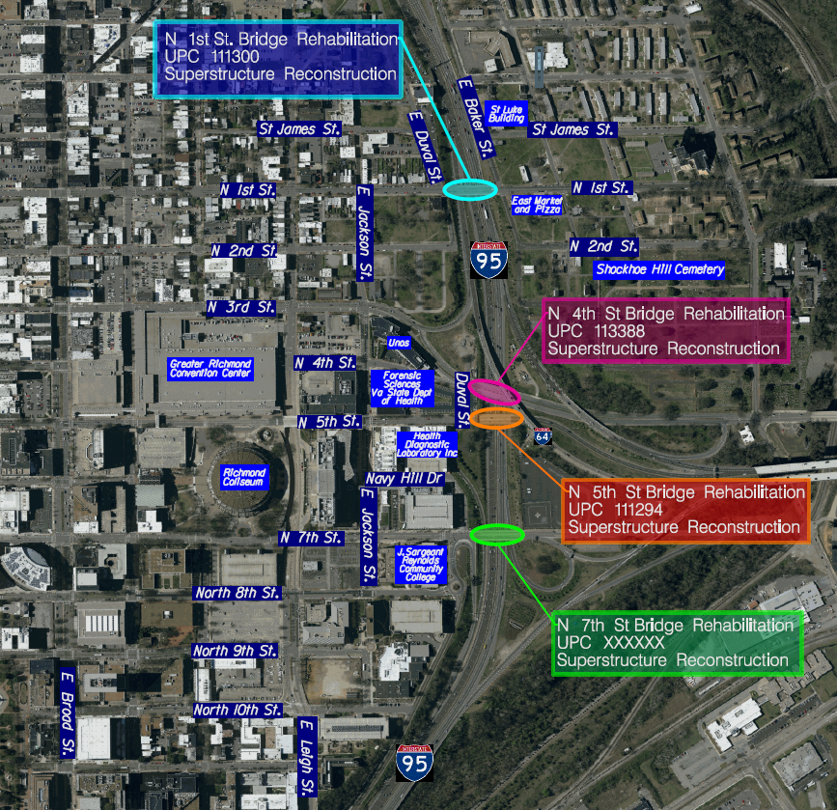
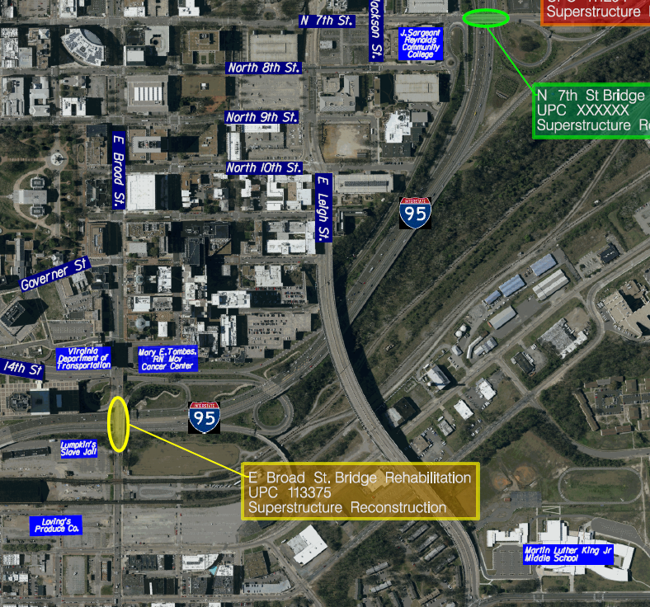
Project Location Map

Slide 5
Project Scope of Work
Superstructure Replacements and Minor Substructure Repairs
  Vertical Clearance – Improvement to 15’-0” (Granted Variance)
  Reduced beam sizes
  Pier concrete resurfacing/crack repair
  Pedestrian fencing & architectural treatments
  Reconstruction of approach slabs and minor roadway approach work
  Utility work to remove and reset active assets currently on structures
Additional Items
  Relocate Guide Signs currently attached to the 1st and 7th St. bridges

Slide 6
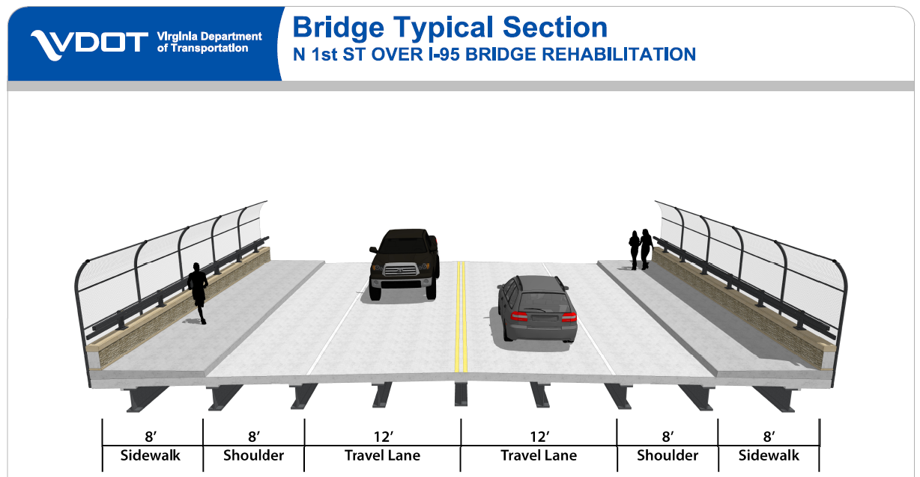
1st St. Over I-95 Bridge Rehabilitation
Proposed Typical Section

Slide 7
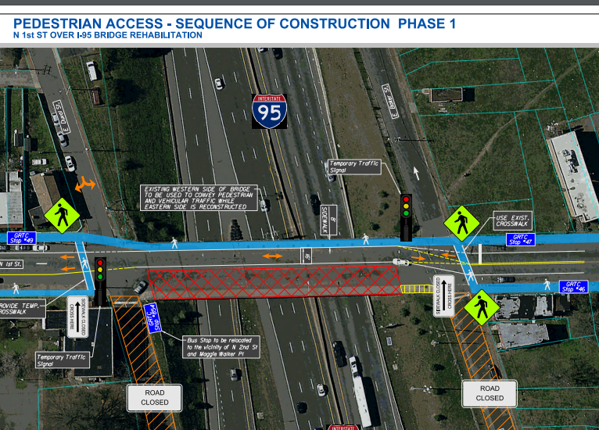
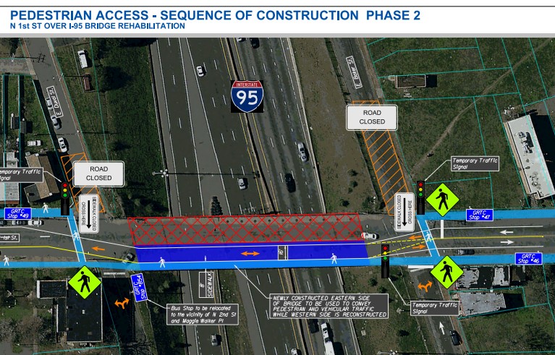
1st St. Over I-95 Bridge Rehabilitation
Proposed Sequence of Construction
Reduction of 1st Street to one lane total with temp. traffic signal
Bikes and pedestrians will be given access to cross the bridge during construction.

Slide 8
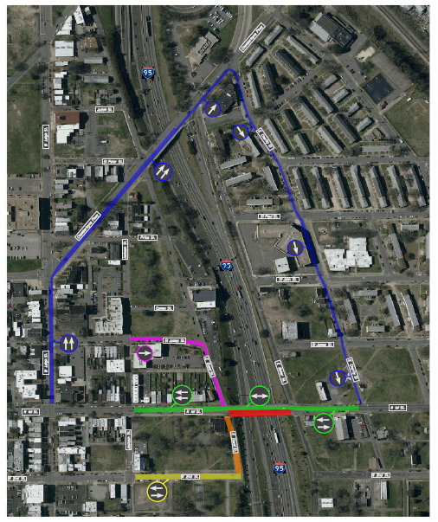
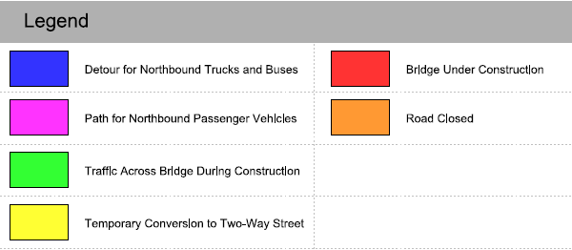
1st St. Over I-95 Bridge Rehabilitation
Proposed Detour Map
Detour for Northbound Trucks and Buses

Slide 9
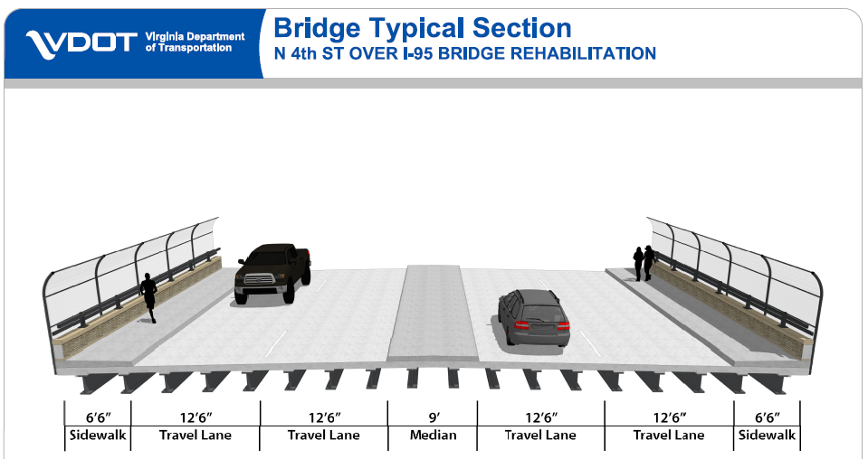
4th St. Over I-95 Bridge Rehabilitation
Proposed Typical Section

Slide 10
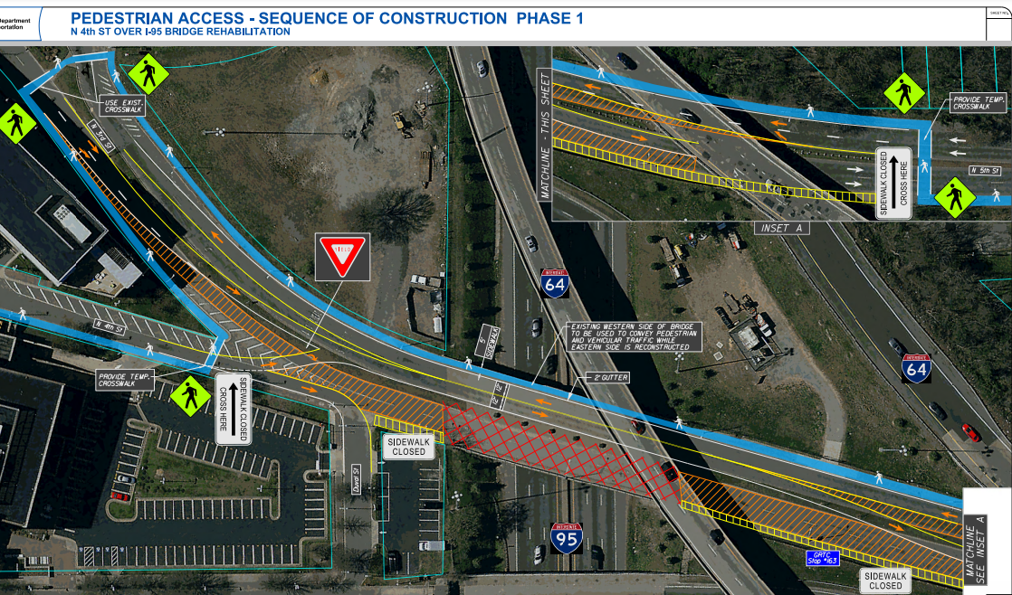
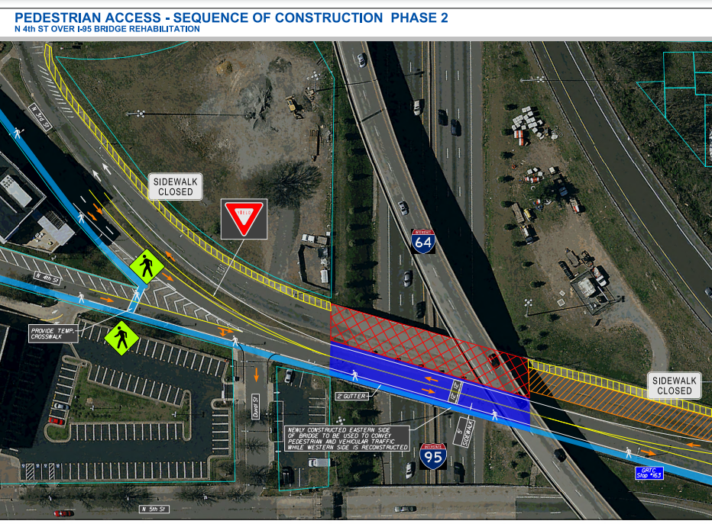
4th St. Over I-95 Bridge Rehabilitation
Proposed Sequence of Construction
One Southbound and one Northbound lane will be open during construction
Bikes and pedestrians will be given access to cross the bridge during construction.

Slide 11
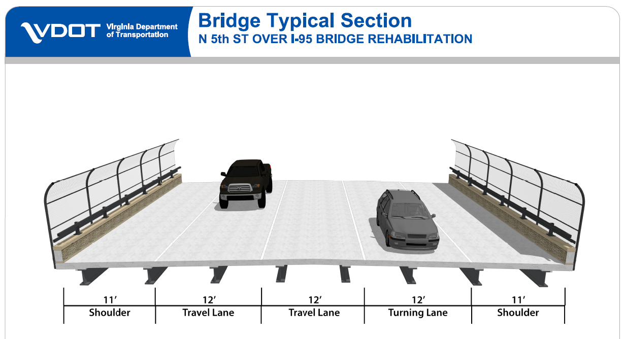
5th St. Over I-95 Bridge Rehabilitation
Proposed Typical Section

Slide 12
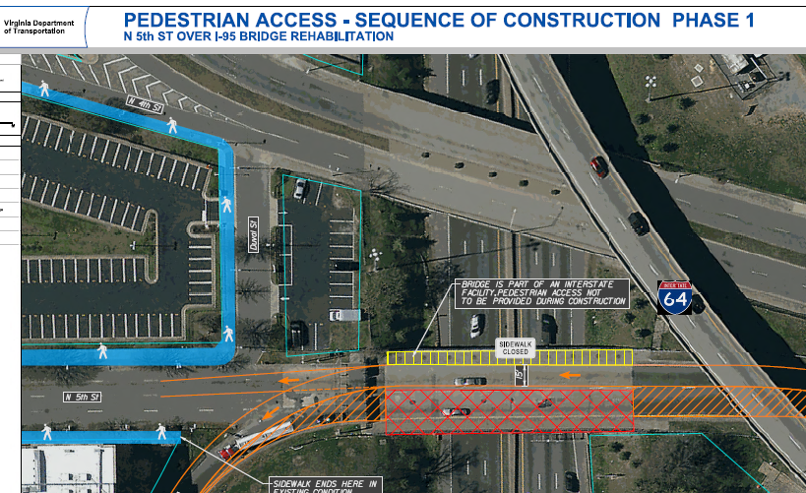
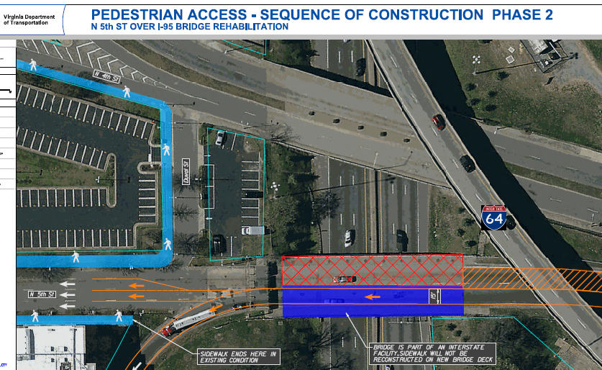
5th St. Over I-95 Bridge Rehabilitation
Proposed Sequence of Construction
One Southbound lane will be open during construction
Bridge is part of the I-64 Westbound off ramp. Bike and pedestrians access will not be provided during construction.

Slide 13
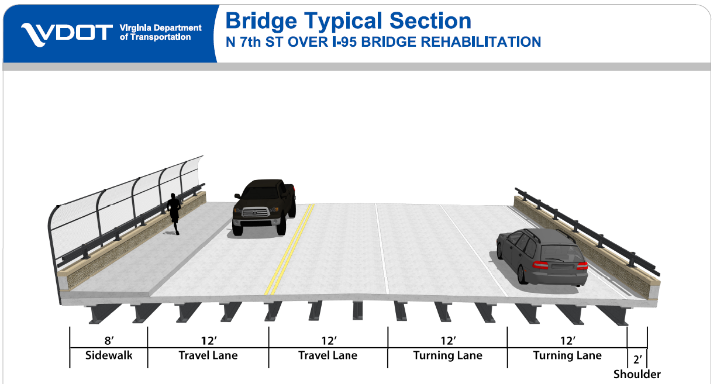
7th St. Over I-95 Bridge Rehabilitation
Proposed Typical Section

Slide 14
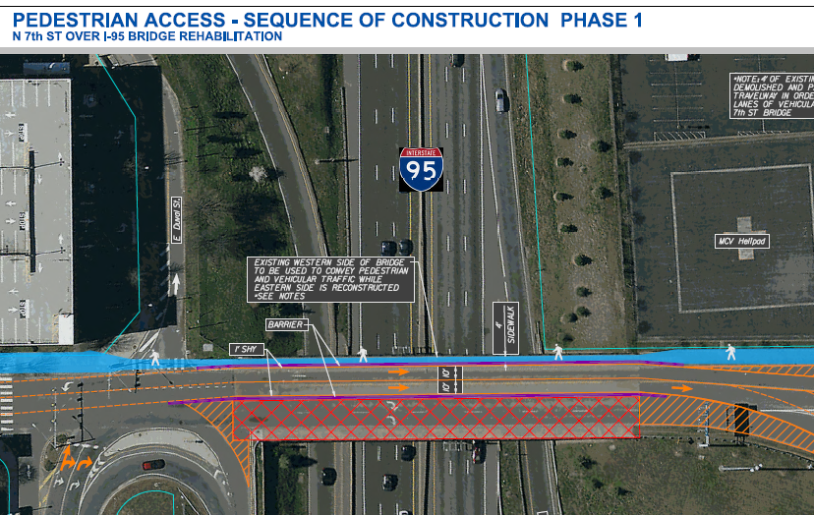
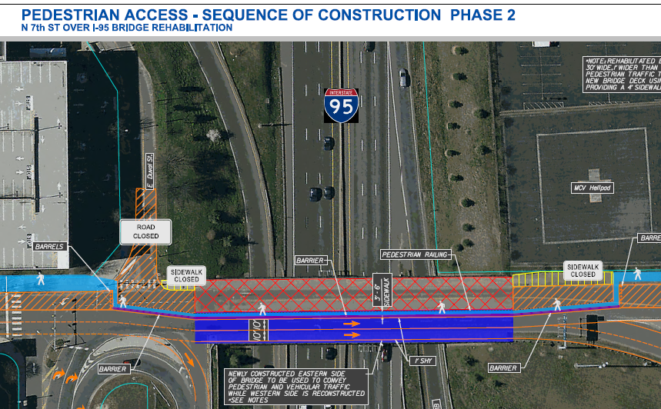
7th St. Over I-95 Bridge Rehabilitation
Proposed Sequence of Construction
Two Northbound lanes of traffic will be open during construction.
Bikes and pedestrians will be given access to cross the bridge during construction.

Slide 15
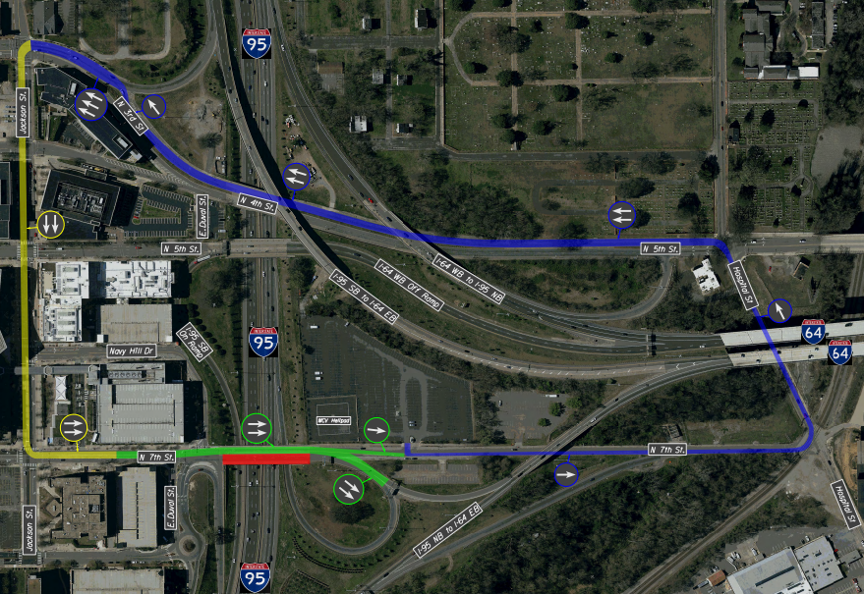
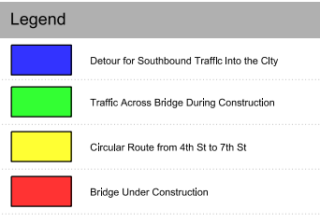
7th St. Over I-95 Bridge Rehabilitation
Proposed Detour Map
Circular detour with 7th and 4th Street for Southbound Traffic into the City

Slide 16
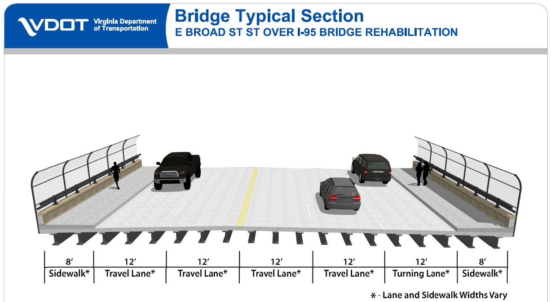
Broad St. Over I-95 Bridge Rehabilitation
Proposed Typical Section

Slide 17
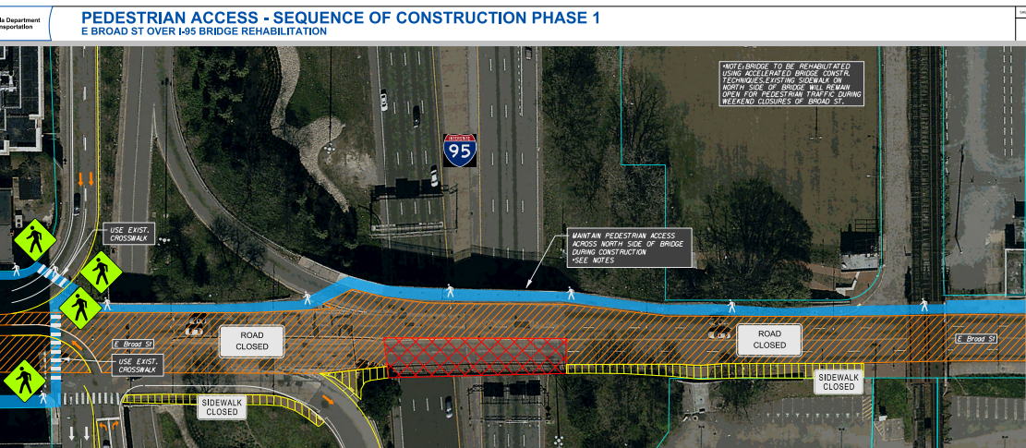
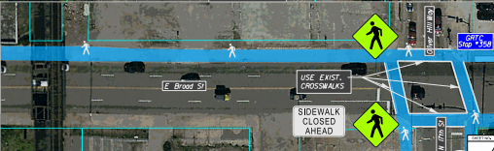
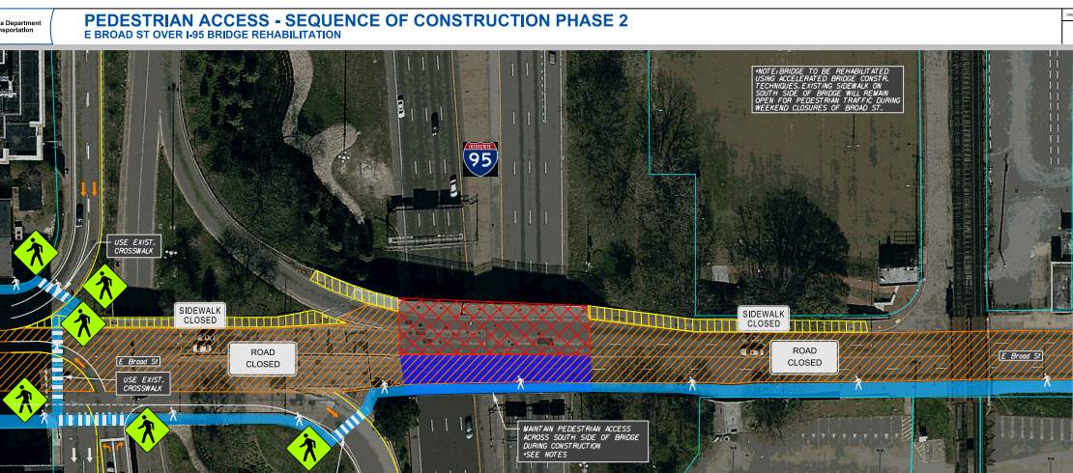
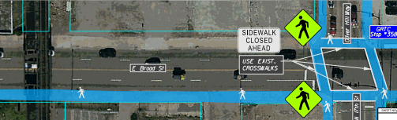
Broad St. Over I-95 Bridge Rehabilitation
Proposed Sequence of Construction
The bridge will be closed on the weekend for construction.
Bikes and pedestrians will be provided access to cross the bridge during the weekend construction.

Slide 18
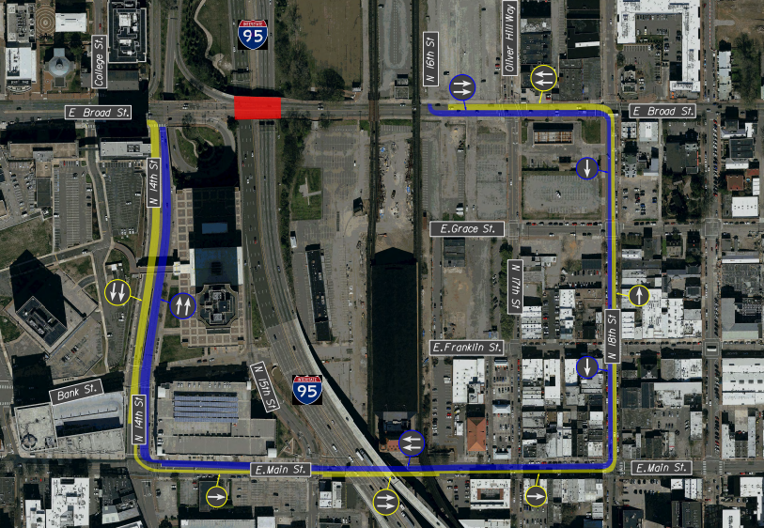
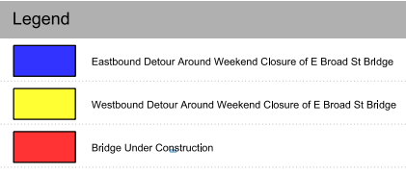
Broad St. Over I-95 Bridge Rehabilitation
Proposed Detour Map
Weekend closures. Vehicle traffic will be detoured to E. Main St.

Slide 19
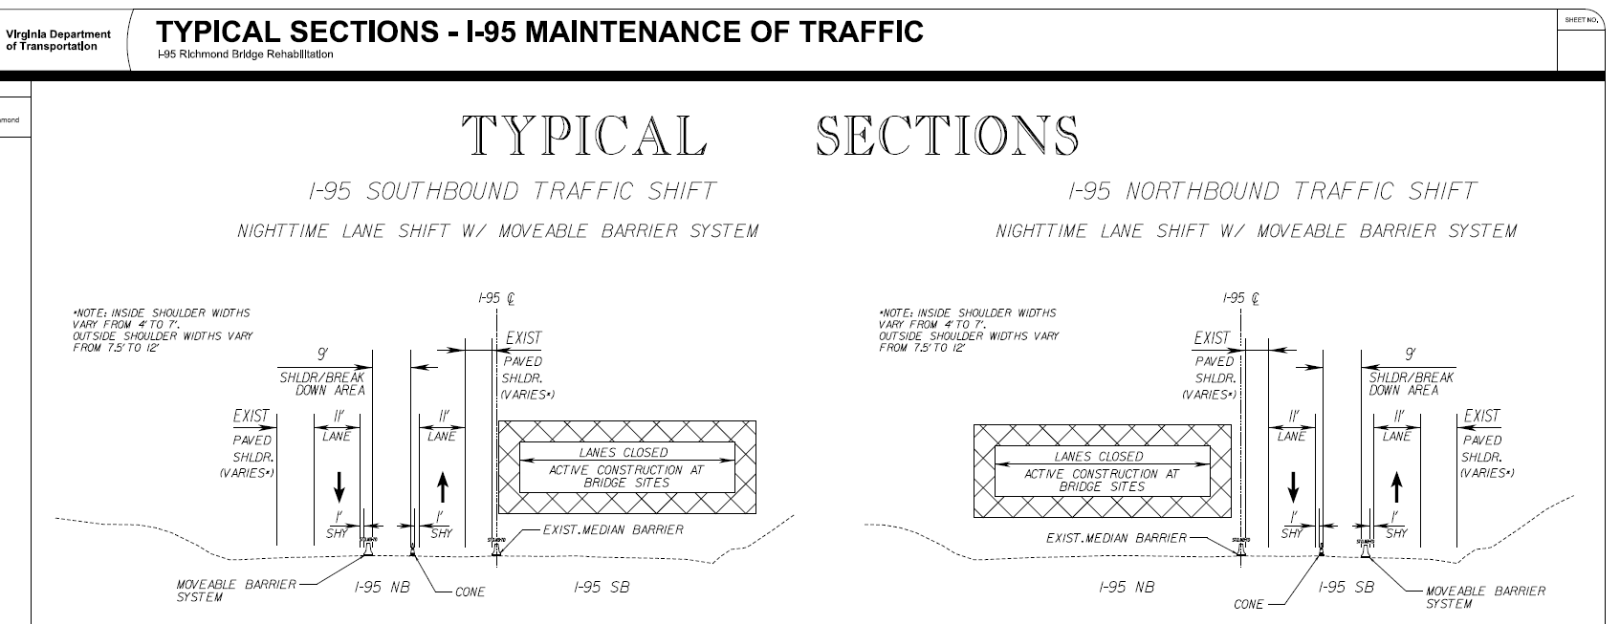
I-95 Proposed Maintenance of Traffic at Night
Reduced to one lane at night for beam placement and deck construction

Slide 20
RFQ SUMMARY
  VDOT Point of Contact (POC)
  Joseph A, Clarke, PE, DBIA
  Alternative Project Delivery Division
  1401 East Broad Street
  Richmond, Virginia 23219
  Phone: (804) 371-4316
  E-mail: joseph.clarke@vdot.virginia.gov
  Two-Phase, Best Value Procurement
  Short-List 3 Highest Ranked Teams
  Estimated Contract Value - $37,000,000

Slide 21
Anticipated Schedule (Section 2.5)
  RFQ Questions to VDOT 01/05/2021 (4:00 PM)
  VDOT Response to Questions 01/12/2021
  SOQ Submission Date 02/02/2021 (4:00 PM)
  Anticipated RFP Release Date 03/31/2021
  Anticipated Award Date 10/20/2021
  Final Completion 12/20/2024

Slide 22
RFQ Information Package (Section 2.8)
  RFQ Conceptual Road and Bridge Plans
  Geotechnical Data Report
  NEPA Documents
  Notice of Willingness Documents
Available for download as one (1) zip file on the Design-Build Request for Qualifications (RFQs) webpage: http://www.virginiadot.org/business/request-for-qualifications.asp

Slide 23
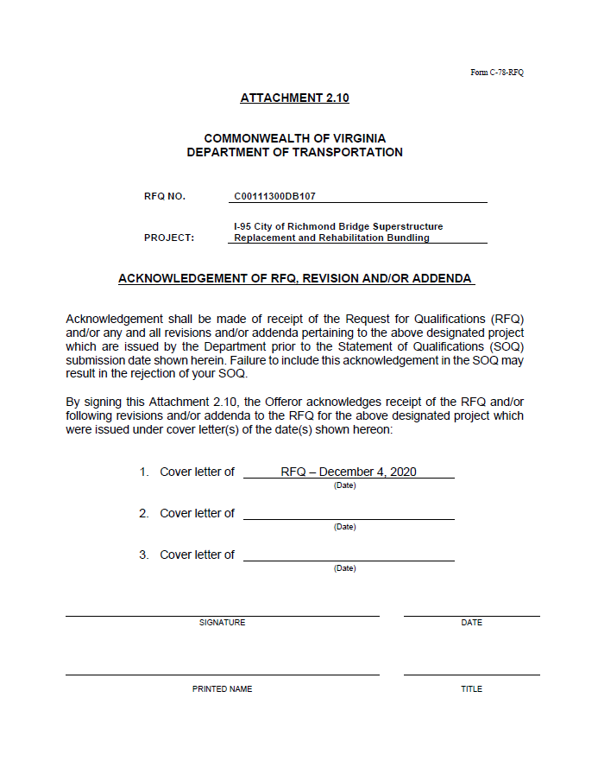
FORM C-78 (ATTACHMENT 2.10)
  Monitor VDOT’s Design-Build RFQ website for responses to RFQ questions and Addendums
  http://www.virginiadot.org/business/request-for-qualifications.asp
Sign, date, and include the C-78 with SOQ

Slide 24
Contents of Statements of Qualifications (SOQ)
  Letter of Submittal (Section 3.2)
    POC & Principal Officer, Corporate Structure, Lead Contractor and Lead Designer, Surety, Evidence of Prequalification, SCC & DPOR information, etc.
    Commitment to achieving a 9% DBE participation goal
    Electronic signatures or scanned signatures are acceptable.

Slide 25
Contents of Statements of Qualifications (SOQ)
  Offeror’s Team Structure (Key Personnel) (Section 3.3)
      Design Build Project Manager
        Responsible for overall Project design, construction, quality management, and contract administration.
      Quality Assurance Manager
        Responsible for QA inspection of all work performed & testing of all materials used.
        No contractual relationship with QC firm and no involvement in construction operations (to include QC inspection and testing).
      Design Manager
        Responsible for coordinating Project design and overseeing QA/QC program for all design disciplines.

Slide 26
Contents of Statements of Qualifications (SOQ)
  Offeror’s Team Structure (Key Personnel) (Section 3.3)
      Construction Manager
        Responsible for managing construction process, to include all Quality Control (QC) activities.
        Required to be on the Project site full time for duration of construction operations.
        Provide a list of current assignments and anticipated duration of each assignment.
      Lead Utility Coordination Manager
        Responsible for the coordination and construction of all utility relocations during the design and construction phases on the project.

Slide 27
Contents of Statements of Qualifications (SOQ)
  Offeror’s Team Structure (Cont.) (Section 3.3)
    Organizational Chart and Narrative
      Clear separation between QA and QC staff
  Experience of Offeror’s Team (Section 3.4)
    Experience with accelerated bridge construction (ABC).
    Delivering projects in developed urban corridors.
    Limiting impacts to the traveling public and affected businesses and communities.
    Innovative bridge design solutions and construction techniques.
    Previous success in the coordination of complex utility relocation/coordination.

Slide 28
Contents of Statements of Qualifications (SOQ)
  Experience of Offeror’s Team (cont.) (Section 3.4)
    Lead Contractor Work History Form
    Lead Designer Work History Form
    Format and Appearance of the Key Personnel Resume Form
    and Work History Forms should not be modified (Section 5.2.2)

Slide 29

Contents of Statements of Qualifications (SOQ)
  Offeror’s proposed team shall remain intact throughout procurement process and, if awarded the contract, the duration of the contract. (Section 11.1)
  Project Risks (Section 3.5)
    Offeror to identify 3 unique Risks critical to the success of the Project
      Why is the risk critical?
      What is the potential impact?
      Mitigation strategies?
      VDOT’s role?

Slide 30
Evaluation Criteria (Section 4)
  Offeror’s Team Structure 20%
  Experience of Offeror’s Team 40%
  Project Risks 40%
  Total 100%
  Design-Build Evaluation Guidelines, Revised September 2019
  http://www.virginiadot.org/business/resources/APD_Docs/APD_Office_Page/DB_Evaluation_Guidelines_9-5-2019.pdf
  Located on VDOT’S D-B Website -- http://www.virginiadot.org/business/design-build.asp

Slide 31
Submittal Requirements (Section 5)
Deadline for submitting an SOQ is February 2, 2021 at 4:00PM
SOQ’s will only be accepted electronically through Bid Express (see next slide for details).
SOQ’s shall be submitted as a single .PDF file; no more than 20 megabytes in size.
The SOQ must be submitted by the Offeror (i.e., not by SubConsultant, SubContractor etc. on the Offeror’s team).

Slide 32
Bid Express
Information regarding Bid Express available on our procurement website under the project: http://www.virginiadot.org/business/request-for-qualifications.asp
  Account Registration
  Frequently Asked Questions
  User Guide
  Vendor Set-up guide
Bid Express requires a paid registration to submit an SOQ.
Deadline for submitting an SOQ is February 2, 2021 at 4:00 PM (EST). You can submit and/or resubmit up until that time. No submissions allowed after due date and time.
It is recommended to test the submission process in advance of final submission. VDOT will not have access to SOQ’s until after February 2, 2021 at 4:00 PM (EST).
DO NOT WAIT UNTIL THE LAST MINUTE TO SUBMIT!

Slide 33

RFQ Questions (Section 6)
  All questions and request for clarifications shall be submitted in writing to the VDOT POC by email.
  Deadline for RFQ Questions submittal is January 5, 2021 (4:00 PM EST)
  Responses will be posted to Bid Express by January 12, 2021

Slide 34
Conflict of Interest (Section 11.2)
The following firms have been determined to have a conflict of interest:
Reynolds, Smith and Hills, Inc. (RS&H)
Johnson, Mirmiran & Thompson, Inc. (JMT)
T3 Design Corporation
Each Offeror shall identify potential conflicts of interest
  See Alternate Project Delivery Office Memorandum IIM-APD-2.2 dated November 9, 2017 http://www.virginiadot.org/business/resources/APD_Docs/APD_Office_Page/IIM-APD-2.2_Final_11-9-2017.pdf
  If a potential conflict of interest or competitive advantage is identified, the Offeror shall submit in writing the pertinent information to VDOT’s POC to seek determination
Embedded Employees within VDOT may pose a potential Conflict of Interest

